Slide 1
8/31/2020
Week_1_Introduction _to_Python_Lab.ipynb - Colaboratory
My Python First Program "Print HeLLo World"
print("Hello World")
Hello World
Variables and Assignment Statements
x=7 y=3
print(x+y)
10
total = x+y print(total)
10
name = "Adam" name2 = "Eva"
print(name , name2)
Adam Eva
Types
x =10
type(x)
int
type(10.5)
float
type(name)

Slide 2
8/31/2020
Week_1_Introduction _to_Python_Lab.ipynb - Colaboratory
str
Arithmetic operators
multiplication = 7*4 print(multiplication)
28
add = 10+15 print(add)
25
sub = 40-8 print(sub)
32
Exponentiation = 2**10 print(Exponentiation)
1024
True Division (/) vs. Floor Division (//)
True_Division = 7/4 print(True_Division)
1.75
Floor_Division = 7//4 print(Floor_Division)
1
remainder = 15%7 print(remainder)
1
Relational Operators

Slide 3
8/31/2020
Week_1_Introduction _to_Python_Lab.ipynb - Colaboratory
x = 105
y = 100
x>y
True
x<y
False
x==y
False
x!=y
True
x>=y
True
x<=y
False
Chaining Comparisons
x = 3
y = 10
1 <= x <= 5
True
1 <= y <= 5
False
Print Function

Slide 4
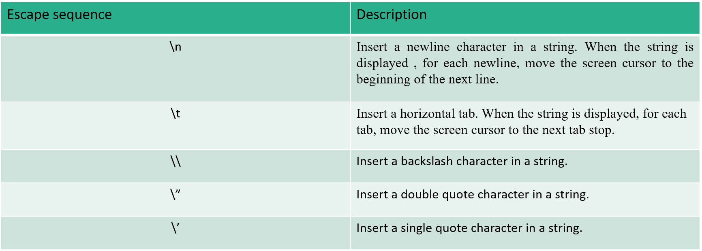
8/31/2020
Week_1_Introduction _to_Python_Lab.ipynb - Colaboratory
Printing a Comma-Separated List of Items
print('Welcome', 'to', 'Python!')
Welcome to Python!
Printing Many Lines of Text with One Statement
print('Welcome\nto\n\nPython!')
Welcome to
Python!
The following table shows some common escape sequences.
Ignoring a Line Break in a Long String
print('this is a longer string, so we \ split it over two lines')
this is a longer string, so we split it over two lines
Printing the Value of an Expression
print('Sum is', 7 + 3)
Sum is 10

Slide 5
8/31/2020
Week_1_Introduction _to_Python_Lab.ipynb - Colaboratory
What does the following print statement display?
print('int(5.2)', 'truncates 5.2 to', int(5.2))
print('int(5.2)', 'truncates 5.2 to', int(5.2))
int(5.2) truncates 5.2 to 5
Including Quotes in Strings
print('Display "hi" in quotes')
Display "hi" in quotes
print('Display \'hi\' in quotes')
#using the \' escape sequence:
Display 'hi' in quotes
print("Display the name O'Brien")
Display the name O'Brien
print("Display \"hi\" in quotes")
Display "hi" in quotes
To avoid using ' and " inside strings, you can enclose such strings in triple quotes:
print("""Display "hi" and 'bye' in quotes""")
Display "hi" and 'bye' in quotes
Multiline Strings
triple_quoted_string = """This is a triple-quoted string that spans two lines"""
print(triple_quoted_string)
This is a triple-quoted string that spans two lines
triple_quoted_string

Slide 6
8/31/2020
Week_1_Introduction _to_Python_Lab.ipynb - Colaboratory
'This is a triple-quoted\nstring that spans two lines'
print("""This is a lengthy multiline string containing a few lines \
of text""")
This is a lengthy
multiline string containing a few lines of text
Precision Handling in Python
a = 3.4536475856
# using "%" to print value till 2 decimal places
print ("The value of number till 2 decimal place(using %) is : ",end="") print ('%.2f' %a)
The value of number till 2 decimal place(using %) is : 3.45
# using "%" to print value till 4 decimal places
print ("The value of number till 2 decimal place(using %) is : ",end="") print ('%.4f' %a)
The value of number till 2 decimal place(using %) is : 3.4536
Getting Input from the User
The built-in input function requests and obtains user input:
name = input("What's your name? ")
What's your name? shifat
print(name)
shifat
value1 = input('Enter first number: ') value2 = input('Enter second number: ')

Slide 7
8/31/2020
Week_1_Introduction _to_Python_Lab.ipynb - Colaboratory
Enter first number: 30 total = value1 + value2 print(total)
3040
type(total) #python takes input as a string we have to type cast the input
str
total = int(value1) + int(value2) #type casting to int format print(total)
70
Getting an Integer from the User by casting the input format
another_value = int(input('Enter another integer: '))
Enter another integer: 10
print(another_value)
10
Taking multiple input from the user
a, b = input().split()
10 20
print(a , b)
10 20
print(type(a))
<class 'str'>
Solving Problem
Determining the Minimum and Maximum with Built-In Functions min and max
Enter second number: 40

Slide 8
8/31/2020
Week_1_Introduction _to_Python_Lab.ipynb - Colaboratory
number1 = int(input('Enter first integer: ')) number2 = int(input('Enter second integer: ')) number3 = int(input('Enter third integer: '))
Enter first integer: 20 Enter second integer: 50 Enter third integer: 100
min(number1,number2,number3)
20
max(number1,number2,number3)
100
Exercises
Create the variables x = 2 and y = 3, then determine what each of the following statements displays:
print('x =', x)
print('Value of', x, '+', x, 'is', (x + x)) print('x =')
print((x + y), '=', (y + x))

